Slide 1

Blackjack VR
By: Vladimir, Munir and elijah

Slide 2
Our Project Goal
Develop a fully functional VR Blackjack game using Unity 3D for Meta Quest 2 headset
Create an immersive virtual reality experience replicating a real-world casino blackjack table ambiance
Design a realistic 3D environment allowing player interaction with cards and chips, betting, and gameplay
Mirror traditional rules of blackjack for an engaging experience
Objectives include creating a 3D environment simulating a blackjack table, intuitive player controls, and a robust betting system.
Notes:
Munir

Slide 3
Did We Reach It?
Reached certain parts of the goal
Overall success, but the scope was too large
Did not implement hand interaction with the world, chips, or cards
Did not obtain a 3D model for the dealer as initially considered
Game works as intended
Robust betting system
Mirrors traditional blackjack rules
Successfully replicates casino ambiance using the environment
Notes:
Elijah

Slide 4
Our Project Scope (Beginning)
Definition of Success:
To make a functioning 3D VR Blackjack Game in Unity3D
Constraints:
Money, expertise and time.
Exclusions:
Multiplayer, AI Bots, Real Money conversion.
Notes:
Vladimir

Slide 5
Our Project Scope (Status Report)
Definition of Success:
Achieve a functional VR Blackjack game maximizing Meta Quest 2 capabilities
Constraints:
Budgetary limitations restrict acquisition of high-quality 3D models
Learning curve in Unity 3D game development and VR headset integration
School laptops with weak CPUs and GPUs pose technical constraints
Time management is critical due to project completion within a few months alongside other classes
Exclusions:
Multiplayer functionality is excluded; the player engages with an AI opponent
No purchases in game
No player movement
Notes:
Elijah

Slide 6
Our Schedule
Week | Description | Elijah | Vlad | Munir
1 | Gather information | Picked project, formed team
2 | Gather information | Looking for assets and software
3 | Gather information | Setting up the project in Unity, learning rules for VR games
4 | Plan project steps | Implemented the assets, began hand tracking and interactivity
5 | Plan project steps | Divide the work we have to do in the future
6 | Decide for an approach | Working on code | Create a build | Work on the UI, menu and buttons.
7 | Decide for an approach
8 | Execute | Shuffling Algorithm and coding logic | Fix the hands model and set the player in the proper place | Fix the hand tracking after the build
9 | Execute |  | Work on the project status and journal entry
10 | Execute | Displaying cards on the table | Work on the code and connect the logic to the different buttons | Making a UI for showing the bet
11 | Execute | Improve the code (Manage win/lose scenarios) | Focus on getting the betting system to work | Work on the rules and the game mechanics(Manage win/lose scenarios)
12 | Execute | Improve the code | Improve the code related to the dealer AI when having to decide whether to hit or fold | Improve the code
13 | Test product | Finding Testing and fixing bugs | Be sure to get a build working | Finding Testing and fixing bugs
14 | Test product | Finding Testing and fixing bugs | Finding Testing and fixing bugs | Finding Testing and fixing bugs
15 | Rate project | Prepare PPT presentation | Prepare PPT presentation | Prepare PPT presentation
Notes:
All of us

Slide 7
Hardware used
Oculus Quest 2 Headset with motion controllers
School Laptops
Desktops with minimum requirements to link to Quest 2:
CPU equivalent to an Intel Core i5-4590, graphics card equivalent to a NVIDIA GeForce GTX 970, and 8GB of RAM
Pros:
Minimum requirements are quite low by today’s standards
Quest 2 is user friendly/Easy to use
Cons:
School laptop hardware does not reach minimum requirements
Linking Quest 2 to PC can be difficult and unnecessarily buggy
Notes:
Munir

Slide 8
Software used
Unity version 2022.3.8f1
Casino Environment (Lumo-Art 3D, 2020)
Hand for VR (NeoCube, 2017)
Git to work in collaboration
Trello to keep track of tasks
Pros:
There is lots of documentation for Unity
It is user friendly
Git allows for reliable stashes of older versions
Cons:
Git merge conflicts are annoying
You can’t delete Trello cards
The assets for our game cost money
Notes:
Munir

Slide 9
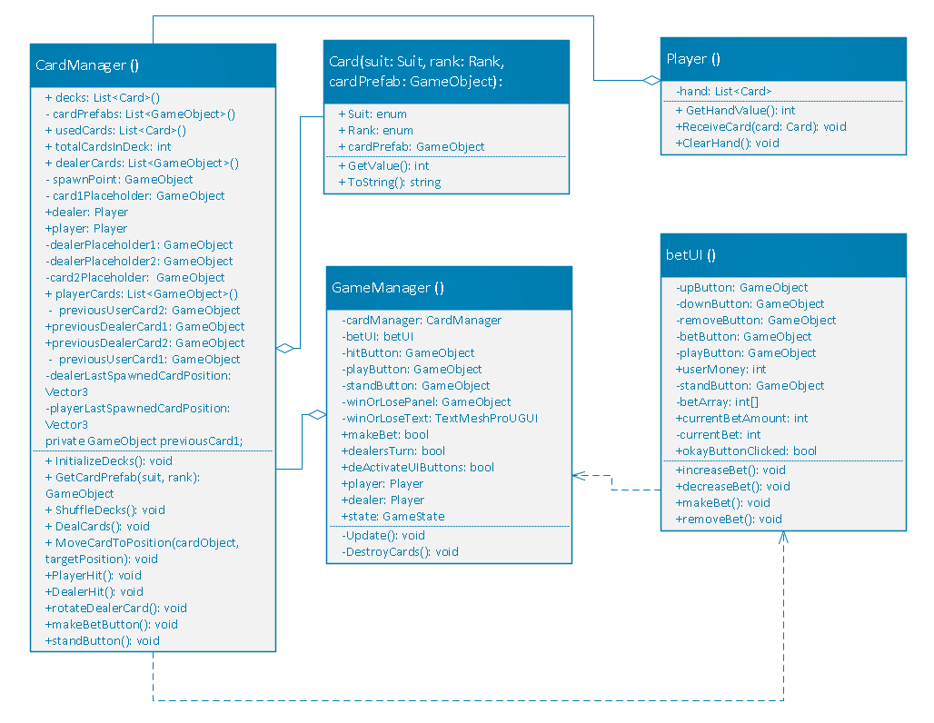
Our Class Diagram
Notes:
Vladimir

Slide 10
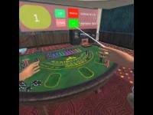
Gameplay Video
Notes:
Elijah

Slide 11
Effects on society of the project result
It provides the player with a casino environment where they can gamble virtual currency, which may help gambling addiction
Helps with having something for fun, helps people who feel lonely.
Does not require internet connection
Notes:
Elijah

Slide 12
Personal project value
Teamwork/Collaboration
Making 3D Unity Game
Troubleshooting Skills
Developing VR game
Notes:
All of us

Slide 13
Thanks

